Slide 1




dabl
Automatic ML with a human in the loop
Andreas Müller
Associate Research Scientist
Columbia University
Scikit-learn Technical Committee

Slide 2
A real world ML workflow
Data Cleaning
Visualization
Model Building
Data Collection
Model Interpretation
Business evaluation

Slide 3
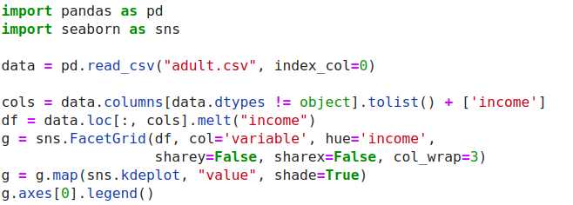
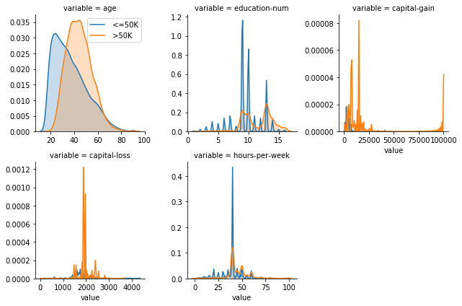
ML with sklearn & pandas

Slide 4
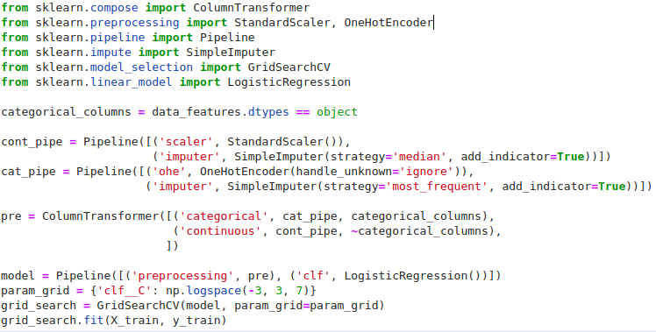
ML with sklearn & pandas

Slide 5
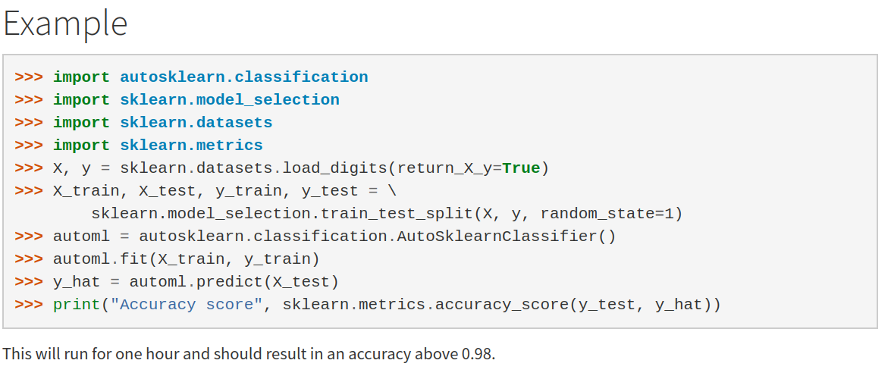
Current Automatic ML frameworks

Slide 6


Slide 7
data
analysis
baseline
library

Slide 8
dabl.clean
dabl.plot
Data Cleaning
Visualization
Model Building
Data Collection
dabl. AnyClassifier
Model Interpretation
Business evaluation
dabl.explain
You actually have to think, sorry.

Slide 9
Data cleaning
& preprocessing

Slide 10
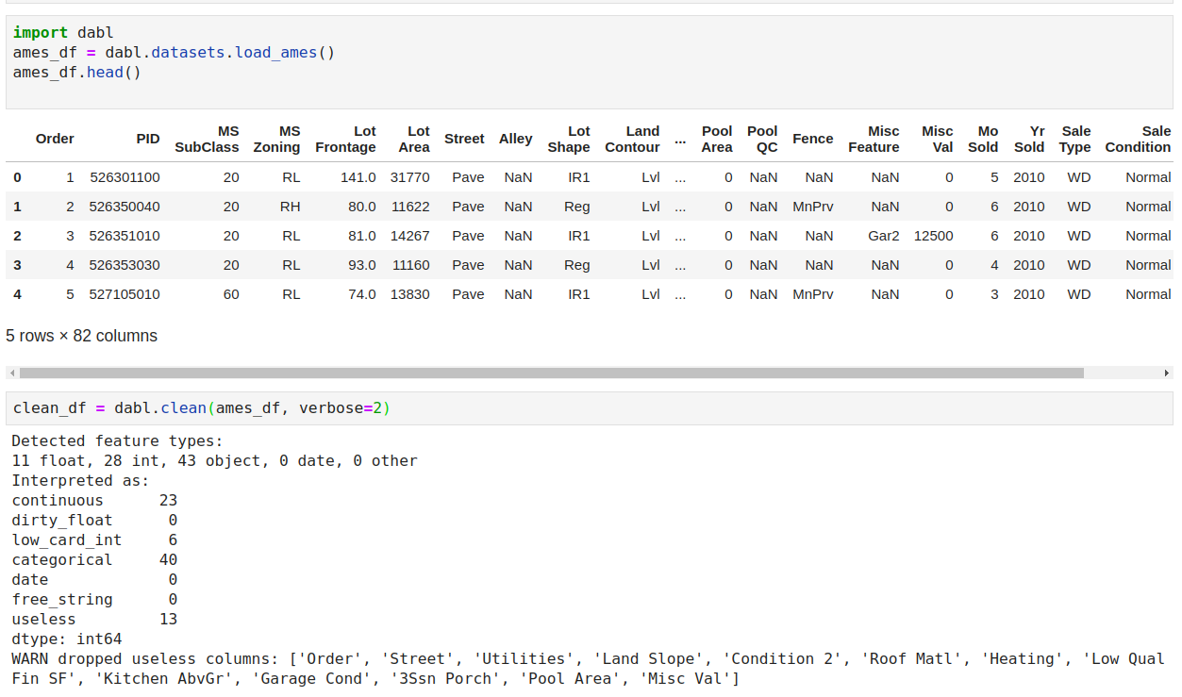

Slide 11
dabl.clean
Detect types (can overwrite)
Detect Missing / rare values
Detect ordinal vs categorical
Detect near-constant
Detect index

Slide 12
Visualization

Slide 13
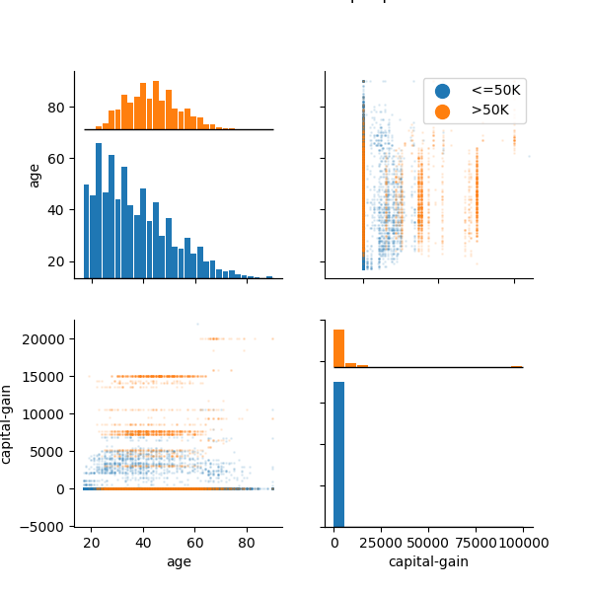
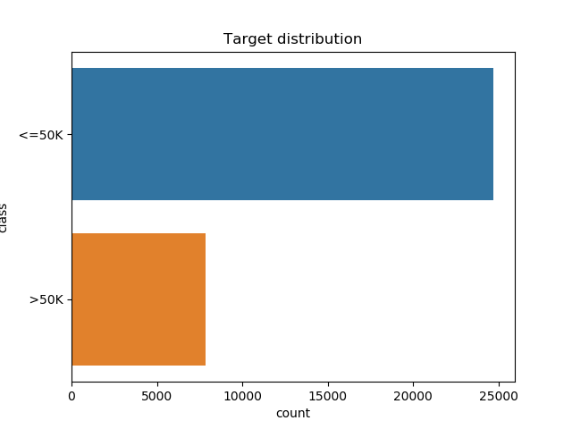
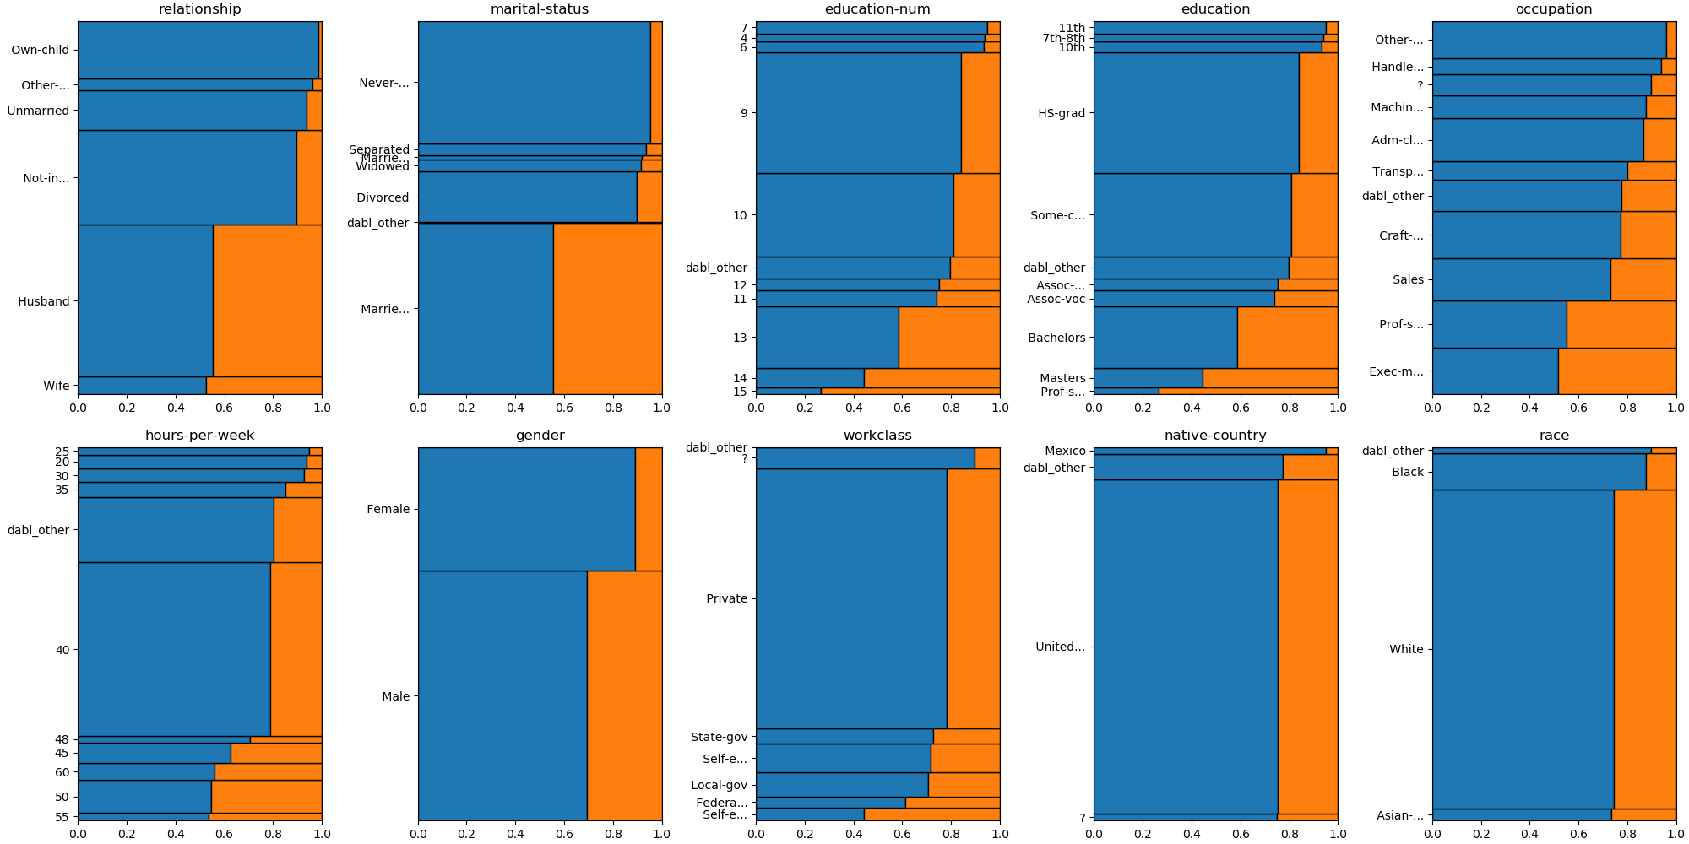
data = pd.read_csv("adult.csv", index_col=0)
plot(data, 'income', scatter_alpha=.1)

Slide 14
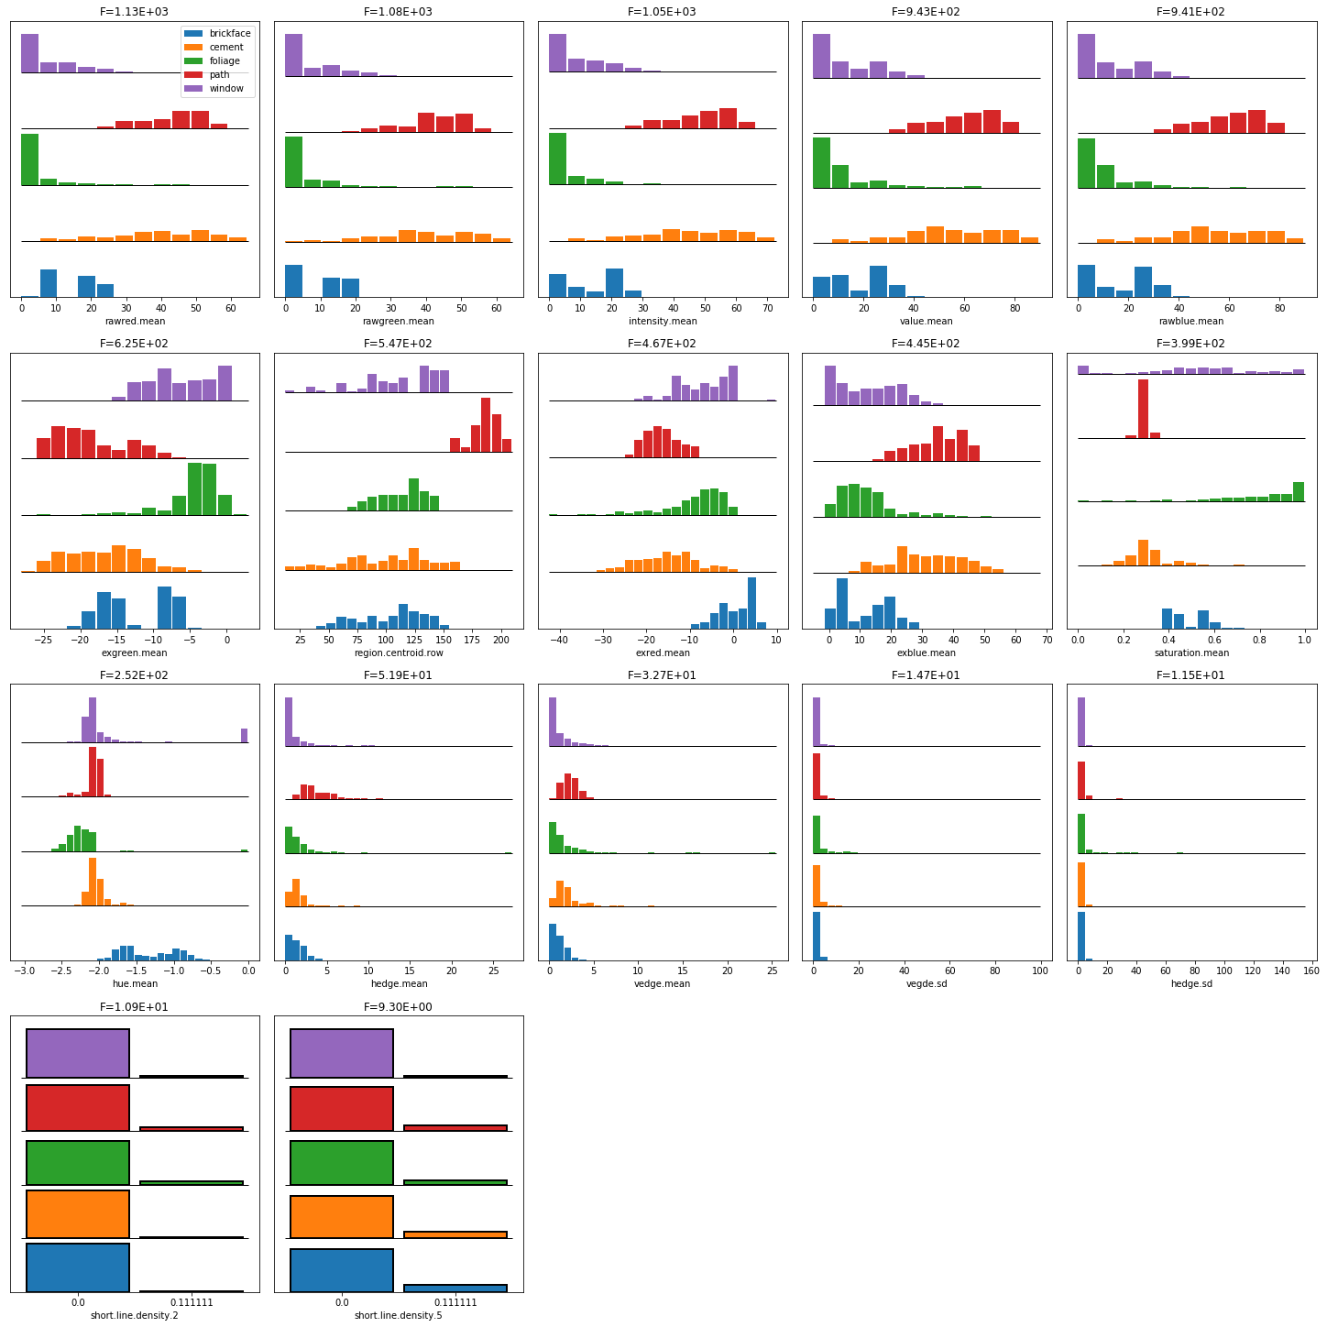
Univariate plots

Slide 15

Mosaic Plots

Slide 16
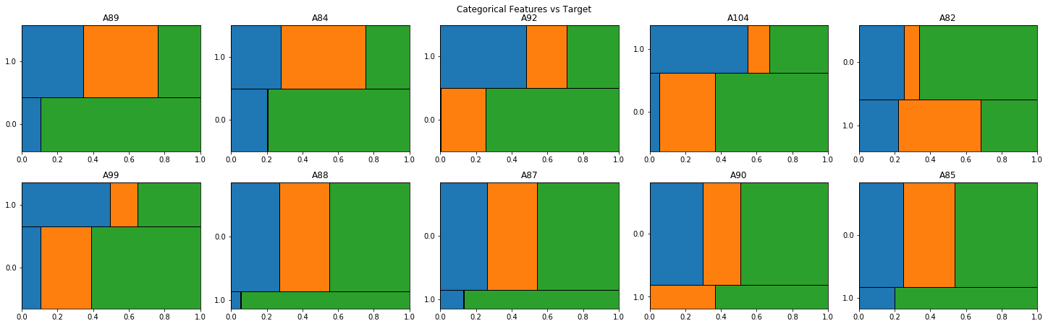
Mosaic Plots

Slide 17
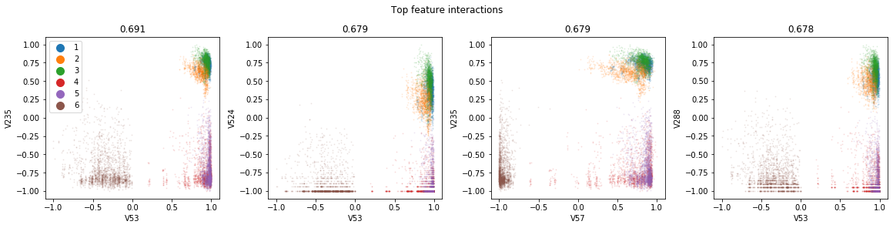
Pairwise Plots

Slide 18
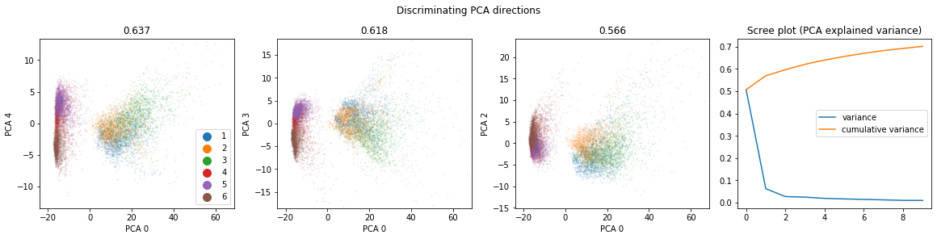
Principal Component Analysis

Slide 19
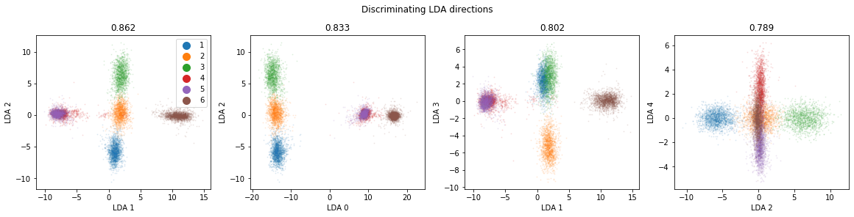
Linear Discriminant Analysis

Slide 20
A note on scatter plots?

Slide 21
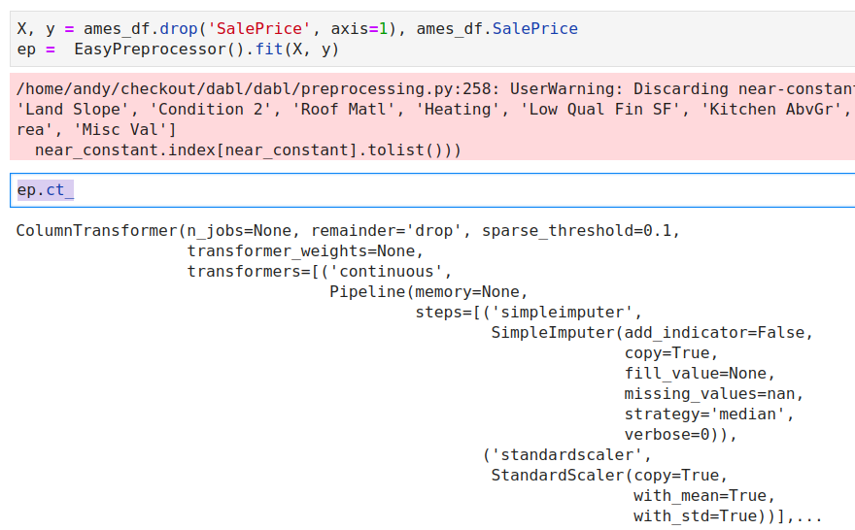
Preprocessing

Slide 22
Simple Prototypes

Slide 23

Dummy Models
Naive Bayes
Stumps
Linear Models

Slide 24
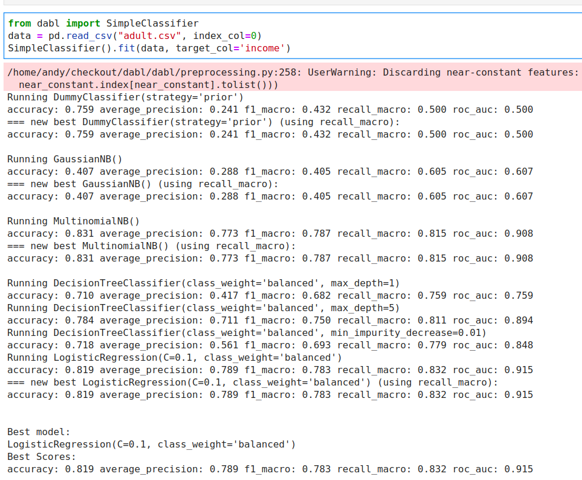
Either X, y
Or dataframe, target_col

Slide 25
Automatic Model Search

Slide 26

Complex Models
More Linear Models
Random forest
Gradient boosting
Kernel methods

Slide 27
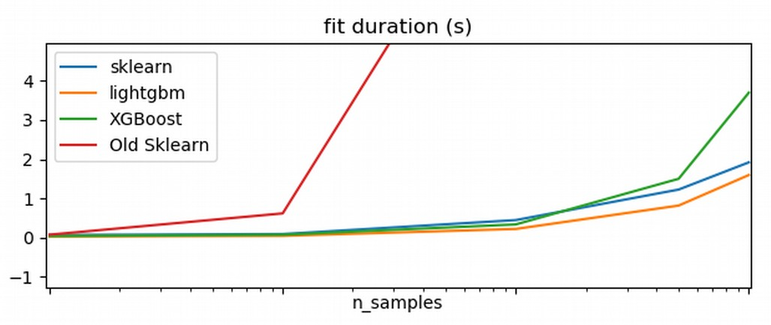

Side note: HistGradientBoosting

Slide 28
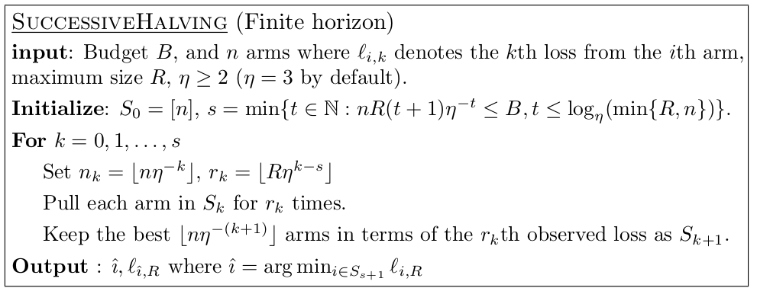
Successive Halving
Given n configuration and budget B
pick η=2 or η=3 (wording follows 2)
Each iteration, keep best halve of configurations
after k=logη(n)+1 left with single configuration.

Slide 29
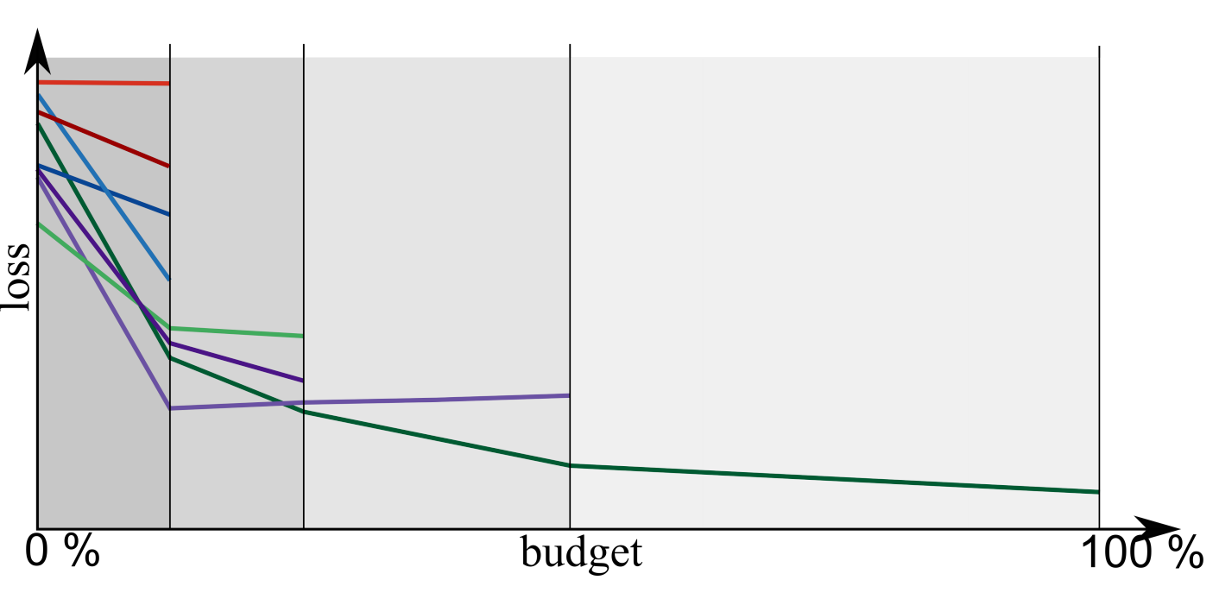
Successive Halving Illustrated

Slide 30
Portfolio creation
Run Hyper-parameter optimization across models on large benchmark suite (OpenML-CC18)
Evaluate all final models across all datasets
Greedily create portfolio of best-performing, diverse models
“Practical Automated Machine Learning
for the AutoML Challenge 2018” Feurer et. al.

Slide 31
Model Explanation

Slide 32
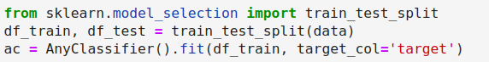
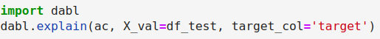

Slide 33
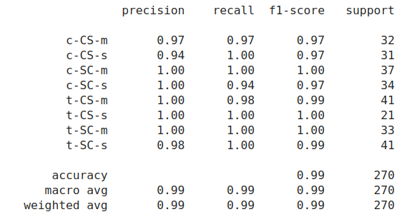
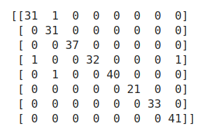
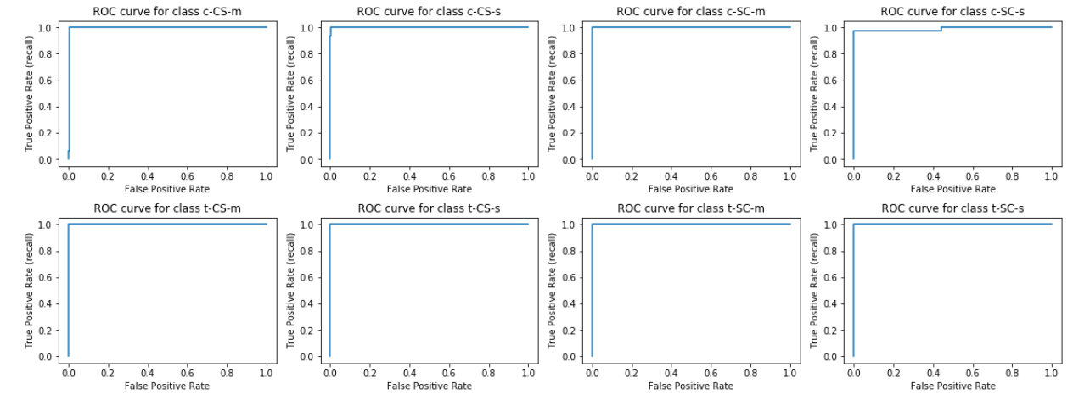
Metrics

Slide 34
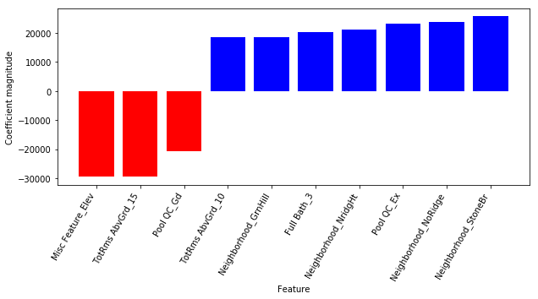
Coefficients / Feature importances

Slide 35
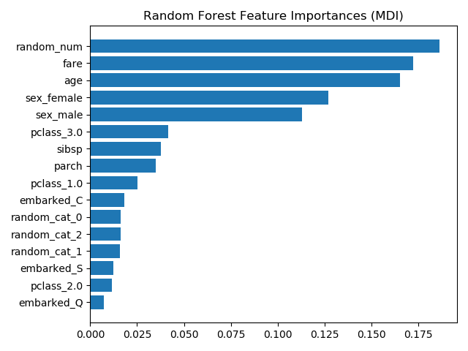
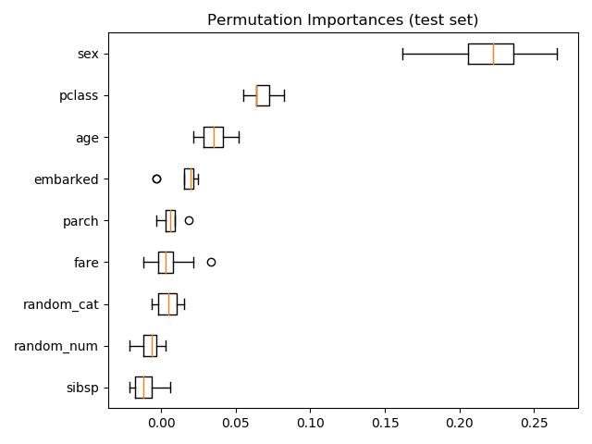
Permutation Importance
https://scikit-learn.org/dev/auto_examples/inspection/plot_permutation_importance.html

Slide 36
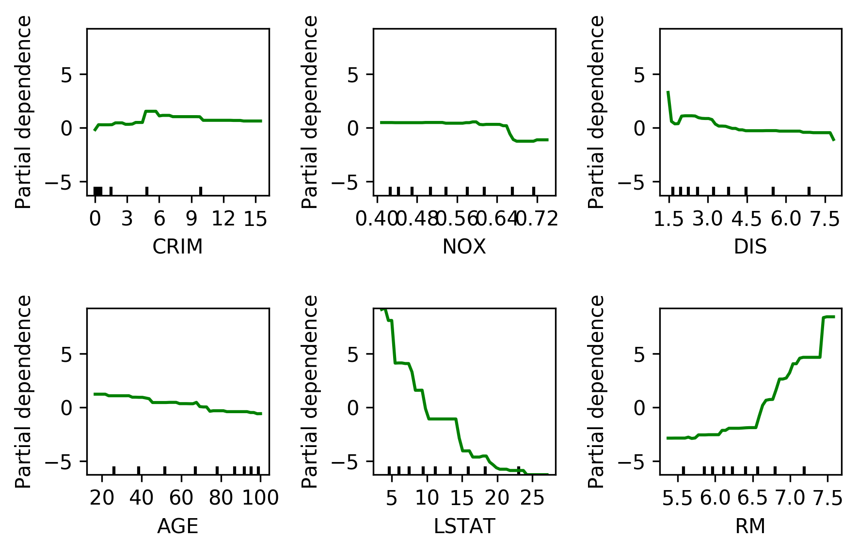
Partial Dependence Plots

Slide 37
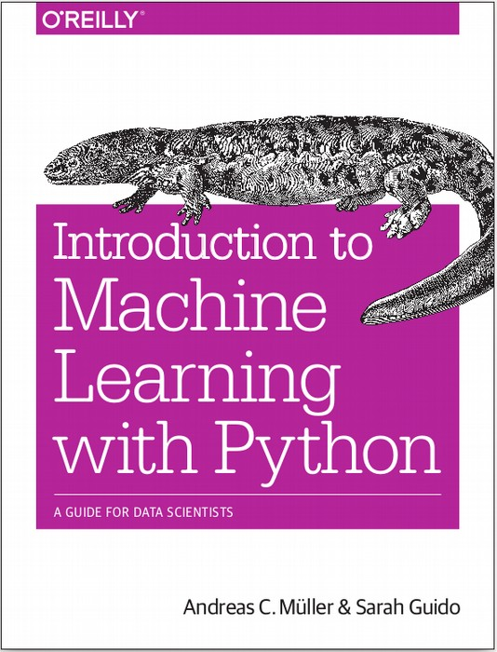




amueller.github.io
@amuellerml
@amueller
andreas.mueller
@columbia.com
Notes:
Thank you for your attention and I’m happy to take any questions!

